Slide 1
Scrapy Tutorial
2022-02-02 覃雄派

Slide 2
Scrapy Tutorial
参考文献
Scrapy tutorial
https://docs.scrapy.org/en/latest/intro/tutorial.html
使用chrome调试xpath
https://www.bbsmax.com/A/n2d9VPoozD/
使用scrapy shell监测页面Xpath规则
https://jingyan.baidu.com/article/908080221414e9fd91c80f97.html

Slide 3
Scrapy 特点
Built-in support for selecting and extracting data from HTML/XML sources using extended CSS selectors and XPath expressions, with helper methods to extract using regular expressions
An interactive shell console (IPython aware) for trying out the CSS and XPath expressions to scrape data, very useful when writing or debugging your spiders
Built-in support for generating feed exports in multiple formats (JSON, CSV, XML) and storing them in multiple backends (FTP, S3, local filesystem)
Robust encoding support and auto-detection, for dealing with foreign, non-standard and broken encoding declarations

Slide 4
Scrapy 特点
Strong extensibility support, allowing you to plug in your own functionality using signals and a well-defined API (middlewares, extensions, and pipelines).
Wide range of built-in extensions and middlewares for handling:
cookies and session handling
HTTP features like compression, authentication, caching
user-agent spoofing
robots.txt
crawl depth restriction
A Telnet console for hooking into a Python console running inside your Scrapy process, to introspect and debug your crawler
Plus other goodies like reusable spiders to crawl sites from Sitemaps and XML/CSV feeds, a media pipeline for automatically downloading images (or any other media) associated with the scraped items, a caching DNS resolver

Slide 5

pause

Slide 6
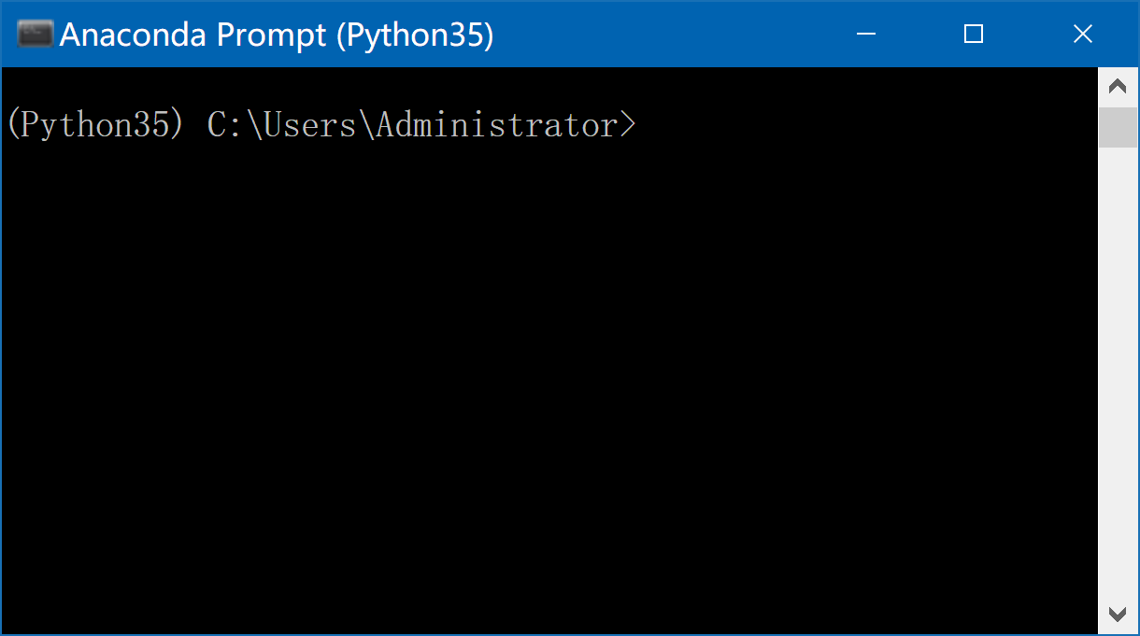
Install Scrapy
Start Anaconda Prompt
cd C:\Users\Administrator
pip install Scrapy
If too slow
pip install Scrapy -i https://pypi.douban.com/simple

Slide 7
pause

Slide 8
The Tutorial
We are going to scrape quotes.toscrape.com, a website that lists quotes from famous authors
This tutorial will walk you through these tasks:
Creating a new Scrapy project
Writing a spider to crawl a site and extract data
Exporting the scraped data using the command line
Changing spider to recursively follow links
Using spider arguments

Slide 9
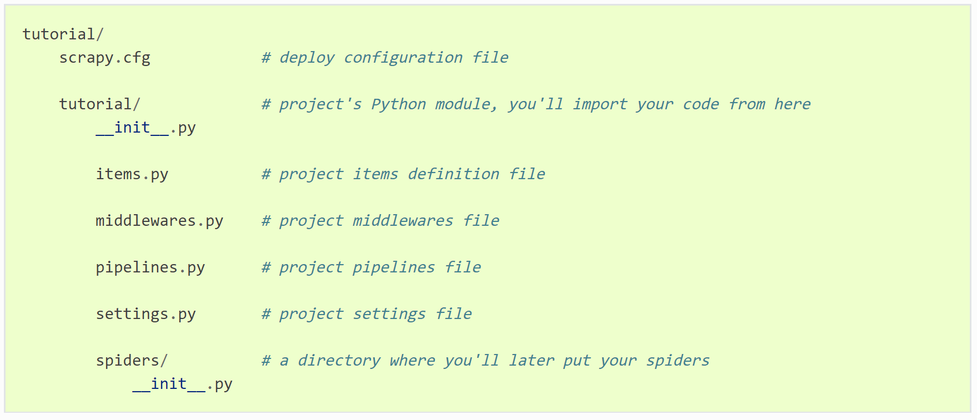
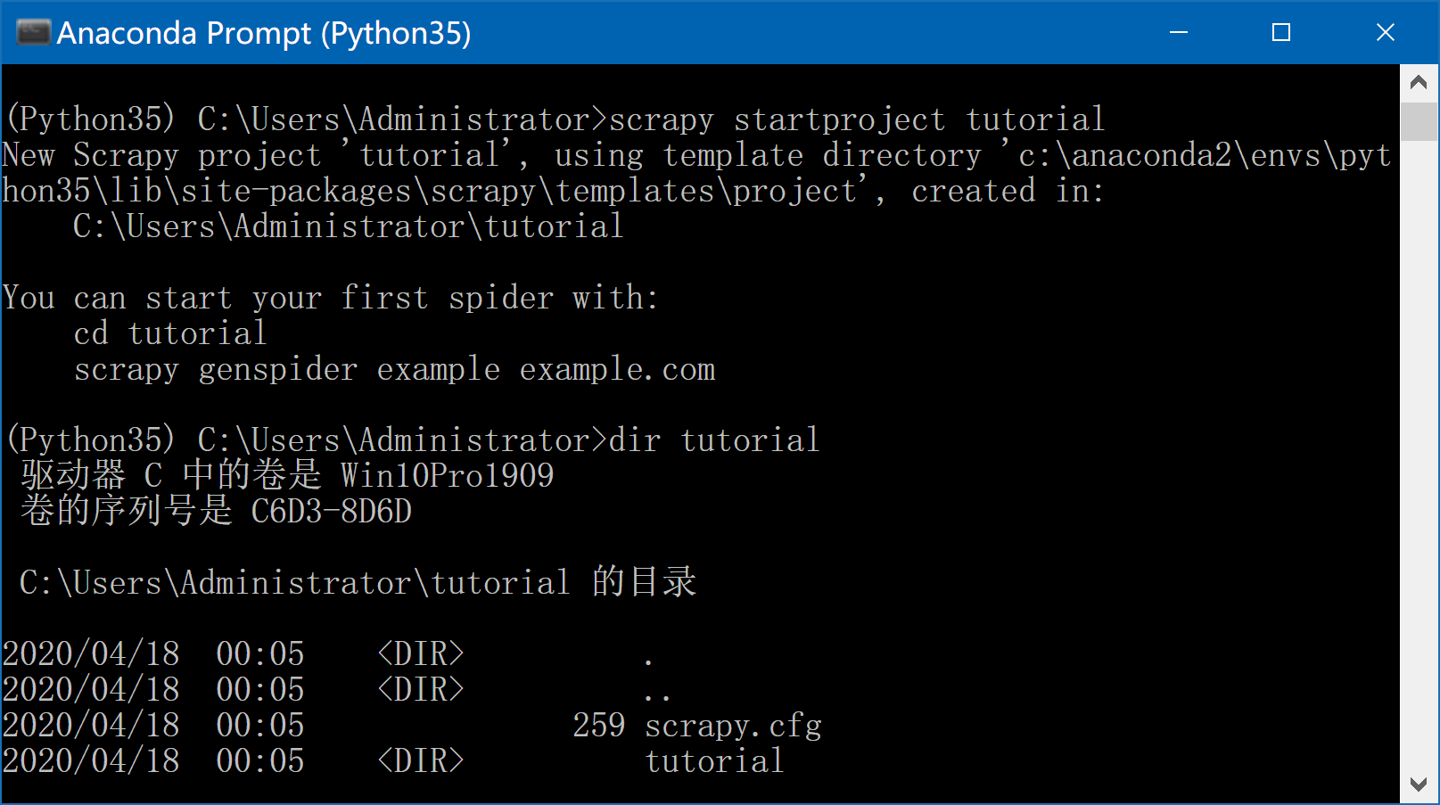
Creating a project
set up a new Scrapy project
Enter a directory where you’d like to store your code and run：
Start Anaconda Prompt
cd C:\Users\Administrator
scrapy startproject tutorial
This will create a tutorial directory with the following contents

Slide 10
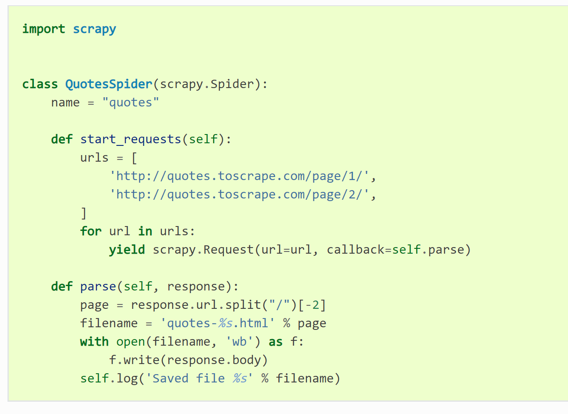
first Spider
Spiders are classes that you define and that Scrapy uses to scrape information from a website (or a group of websites).
They must subclass Spider and define the initial requests to make, optionally how to follow links in the pages, and how to parse the downloaded page content to extract data.
identifies the Spider
Subsequent requests will be generated successively from these initial requests
handle the response downloaded
quotes_spider.py under the tutorial/spiders directory in your project
The parse() method usually parses the response, extracting the scraped data as dicts and also finding new URLs to follow and creating new requests (Request) from them

Slide 11
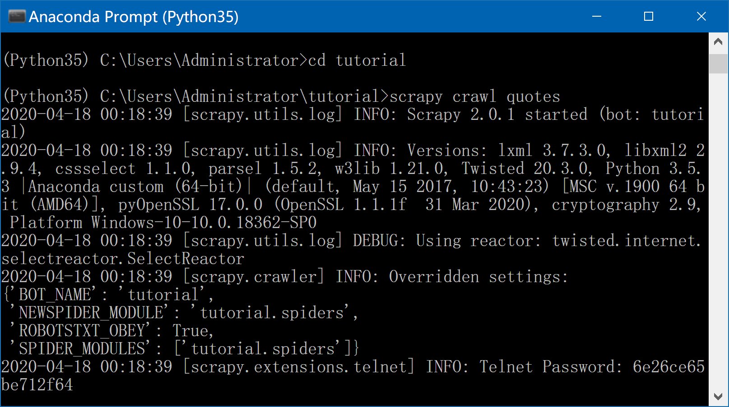
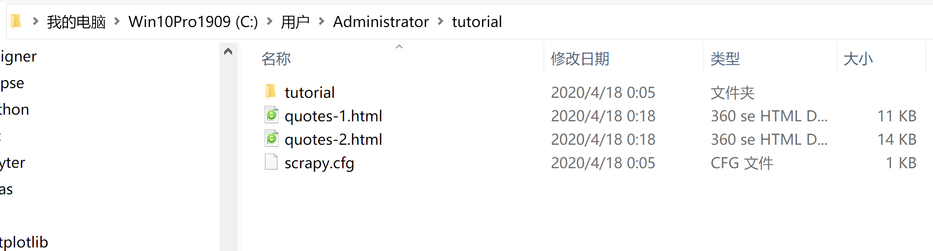
run our spider
Start Anaconda Prompt
cd C:\Users\Administrator\tutorial
scrapy crawl quotes
爬虫的名称
下载两个网页

Slide 12
pause

Slide 13
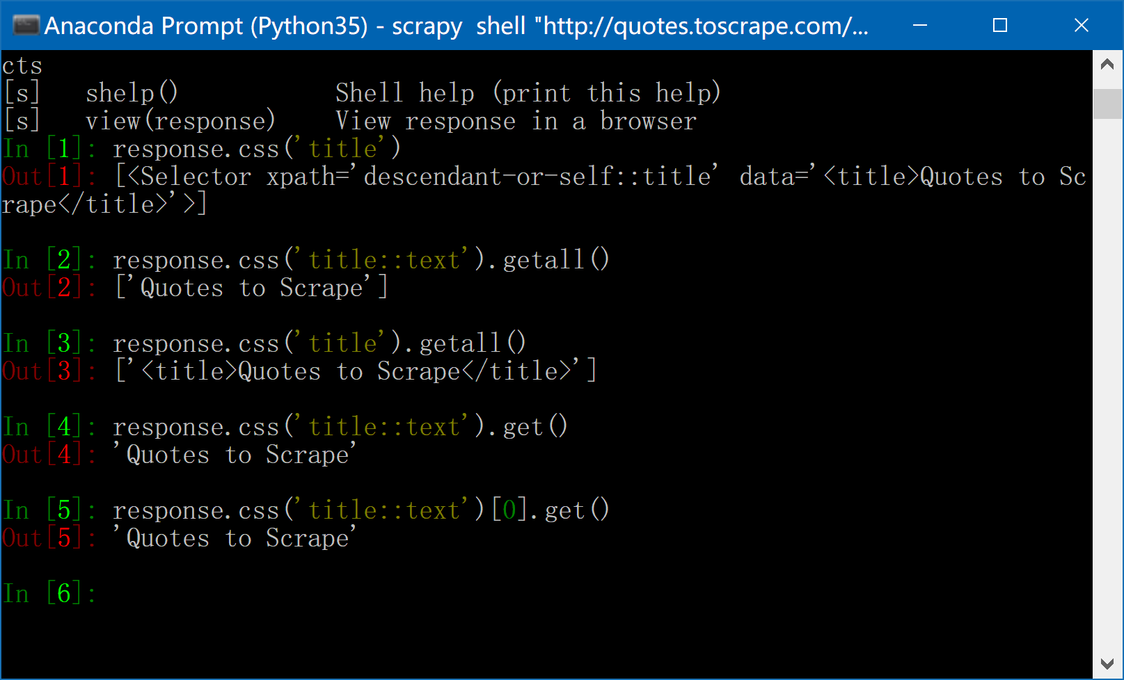
Extracting data
Start Scrapy shell
Start Anaconda Prompt
cd C:\Users\Administrator
scrapy shell "http://quotes.toscrape.com/page/1/"
尝试如下命令
response.css('title')
response.css('title::text').getall()
response.css('title').getall()
response.css('title::text').get()
response.css('title::text')[0].get()

Slide 14
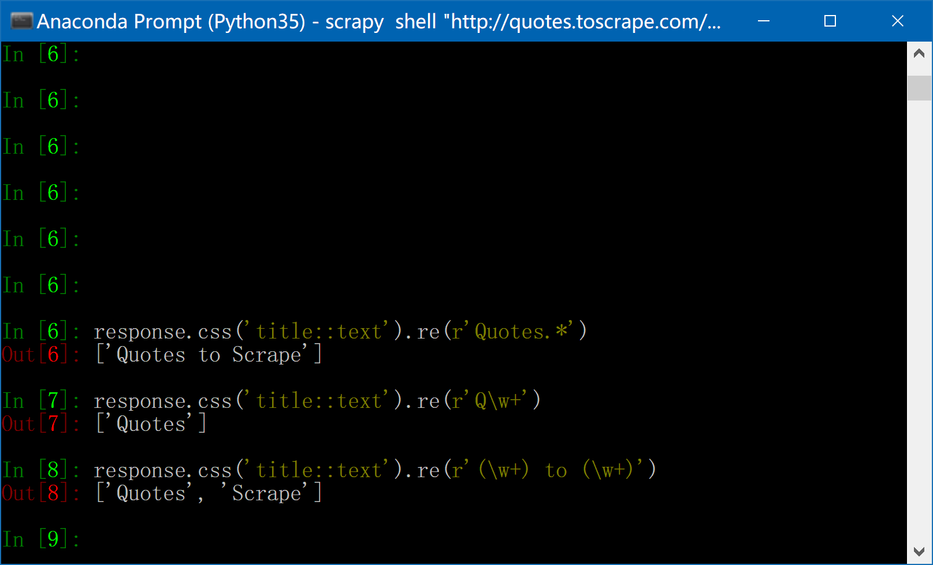
Extracting data
Start Scrapy shell
Start Anaconda Prompt
cd C:\Users\Administrator
scrapy shell "http://quotes.toscrape.com/page/1/"
尝试如下命令
response.css('title::text').re(r'Quotes.*')
response.css('title::text').re(r'Q\w+')
response.css('title::text').re(r'(\w+) to (\w+)')

Slide 15
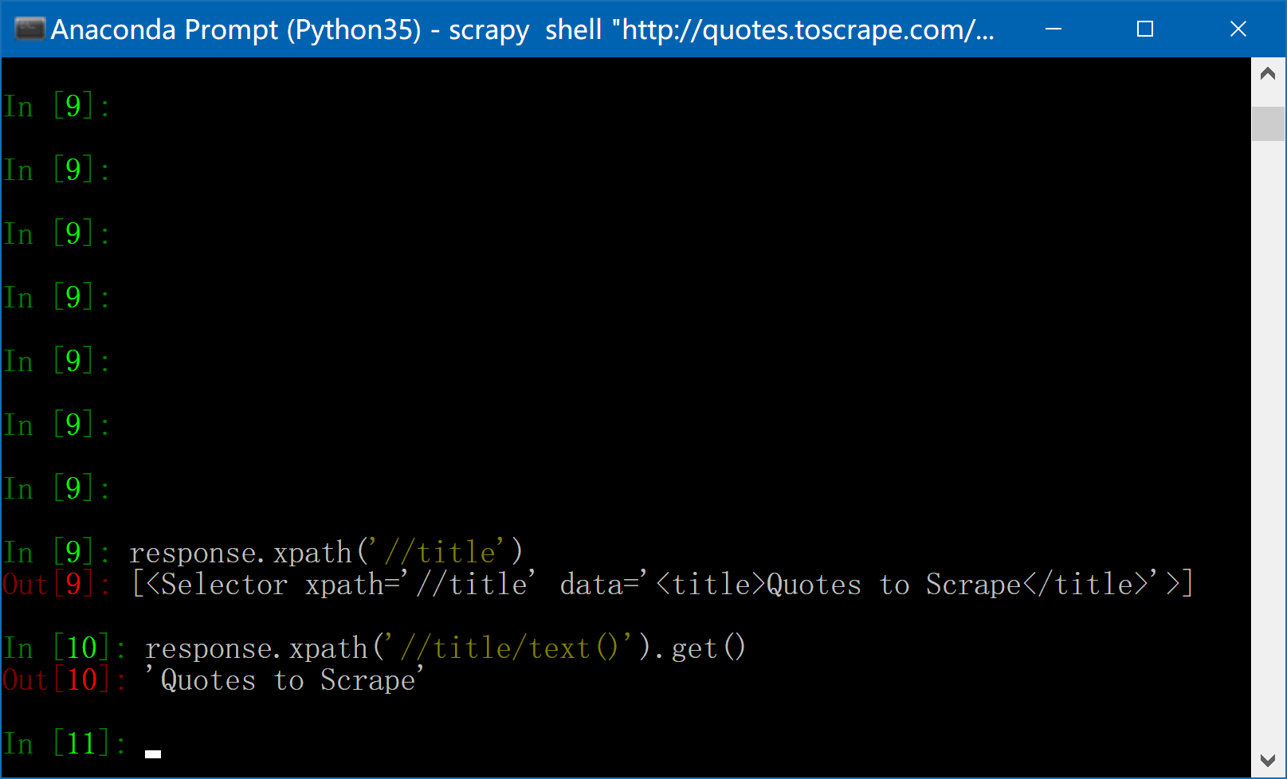
Extracting data
Start Scrapy shell
Start Anaconda Prompt
cd C:\Users\Administrator
scrapy shell "http://quotes.toscrape.com/page/1/"
尝试如下命令(Xpath)
response.xpath('//title')
response.xpath('//title/text()').get()

Slide 16
pause

Slide 17
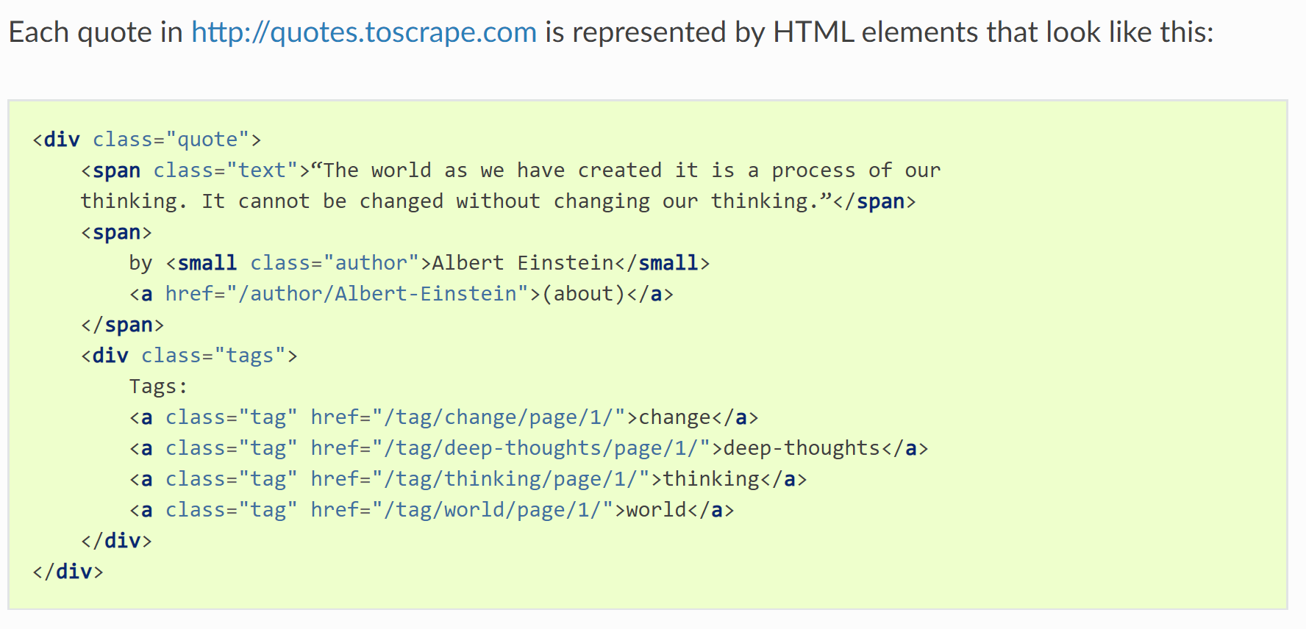
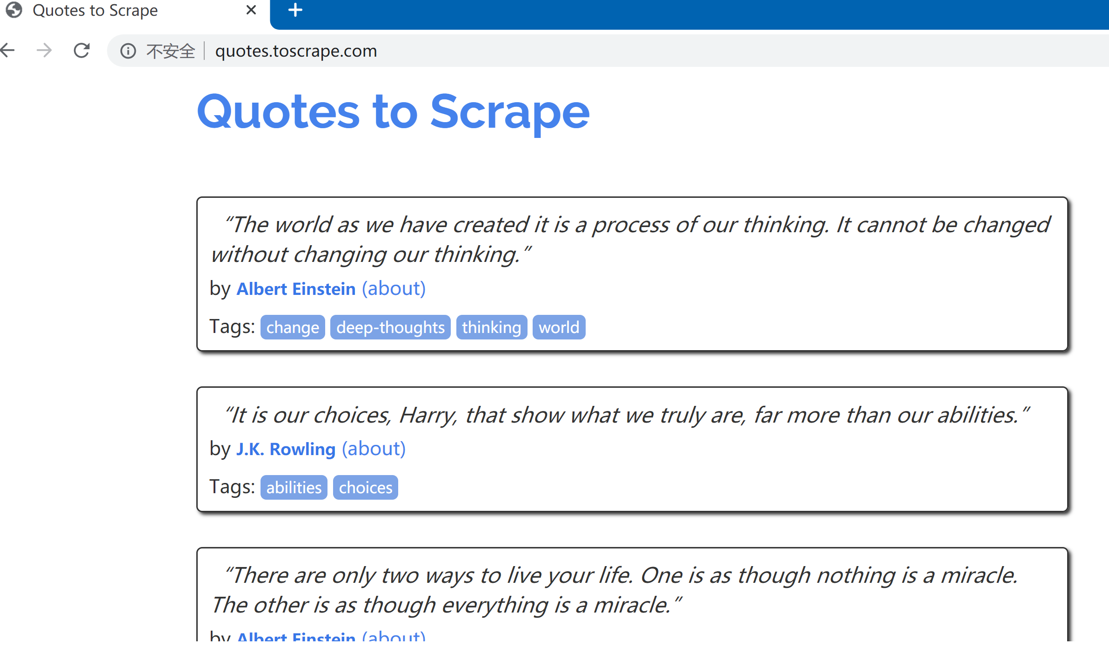
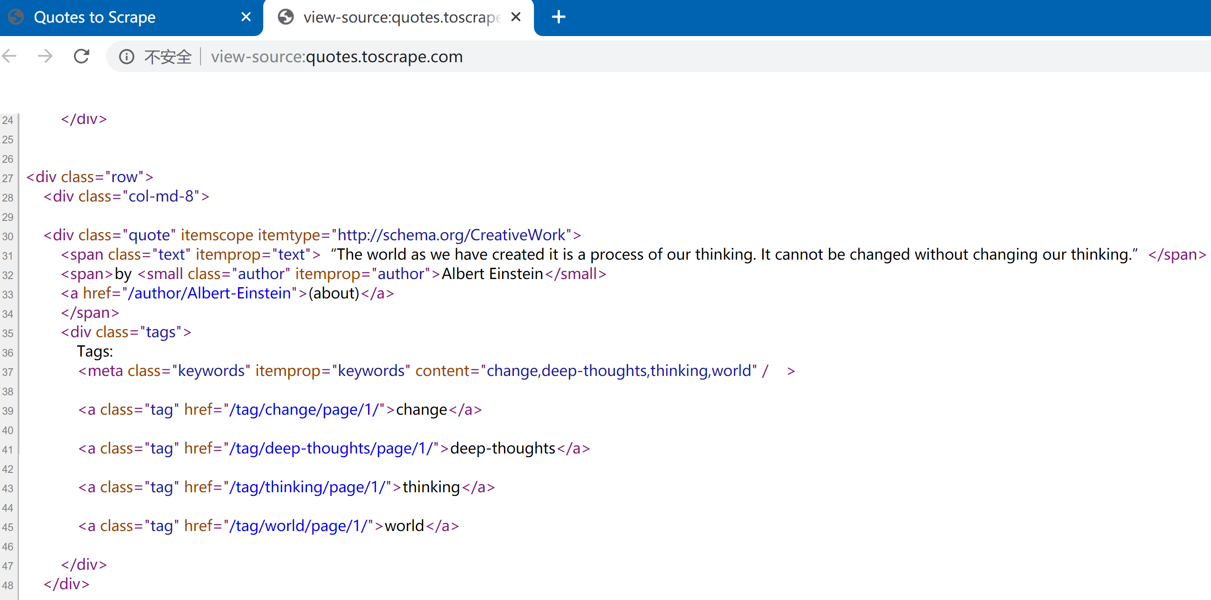
Extracting quotes and authors
提取每个Quote及其author

Slide 18
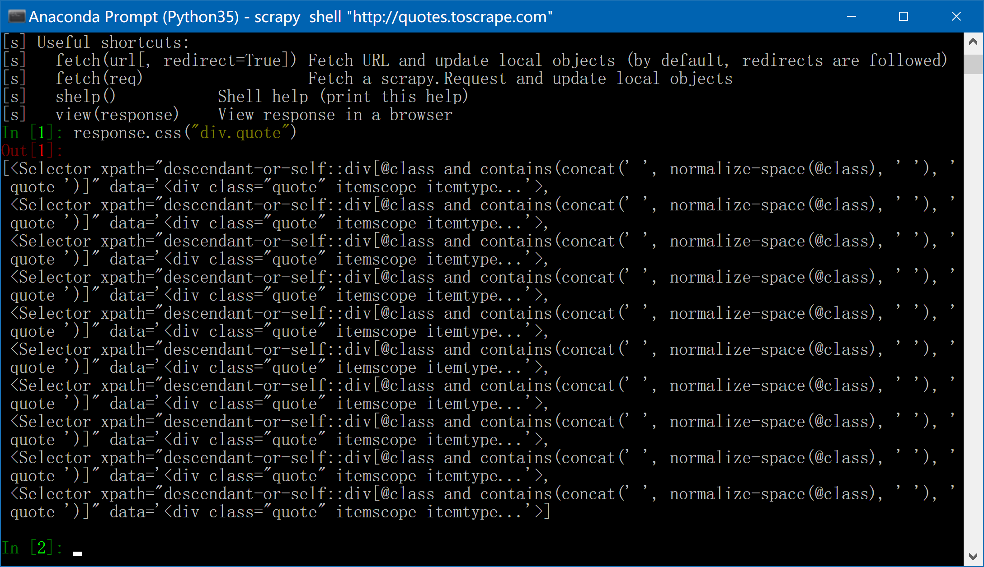
Extracting quotes and authors
Start Scrapy shell
Start Anaconda Prompt
cd C:\Users\Administrator
scrapy shell "http://quotes.toscrape.com"
尝试如下命令
response.css("div.quote")

Slide 19
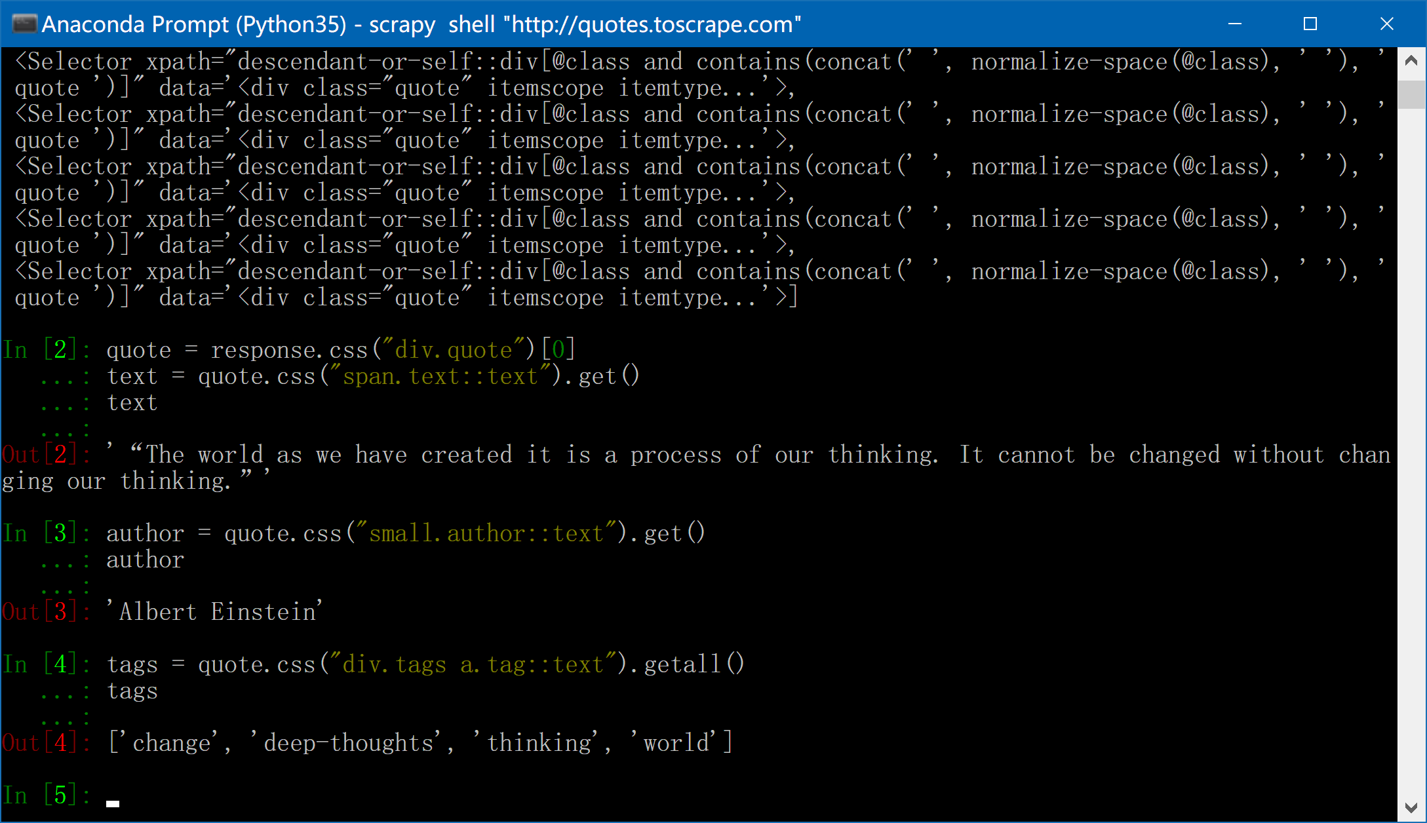
Extracting quotes and authors
Start Scrapy shell
Start Anaconda Prompt
cd C:\Users\Administrator
scrapy shell "http://quotes.toscrape.com"
尝试如下命令
quote = response.css("div.quote")[0]
text = quote.css("span.text::text").get()
text
author = quote.css("small.author::text").get()
author
tags = quote.css("div.tags a.tag::text").getall()
tags
提取下标为0的quote的细节信息

Slide 20
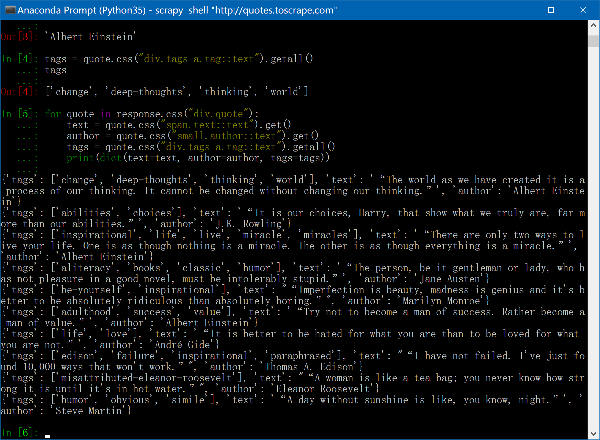
Extracting quotes and authors
Start Scrapy shell
Start Anaconda Prompt
cd C:\Users\Administrator
scrapy shell "http://quotes.toscrape.com"
尝试如下命令
for quote in response.css("div.quote"):
text = quote.css("span.text::text").get()
author = quote.css("small.author::text").get()
tags = quote.css("div.tags a.tag::text").getall()
print(dict(text=text, author=author, tags=tags))
把所有quote的细节信息
都打印一遍

Slide 21
pause

Slide 22
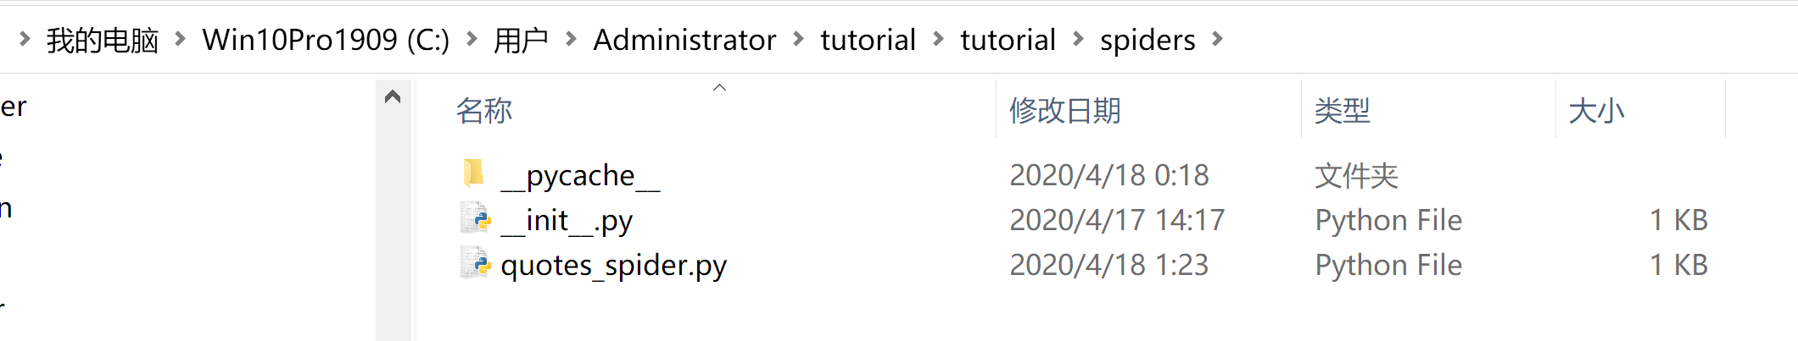
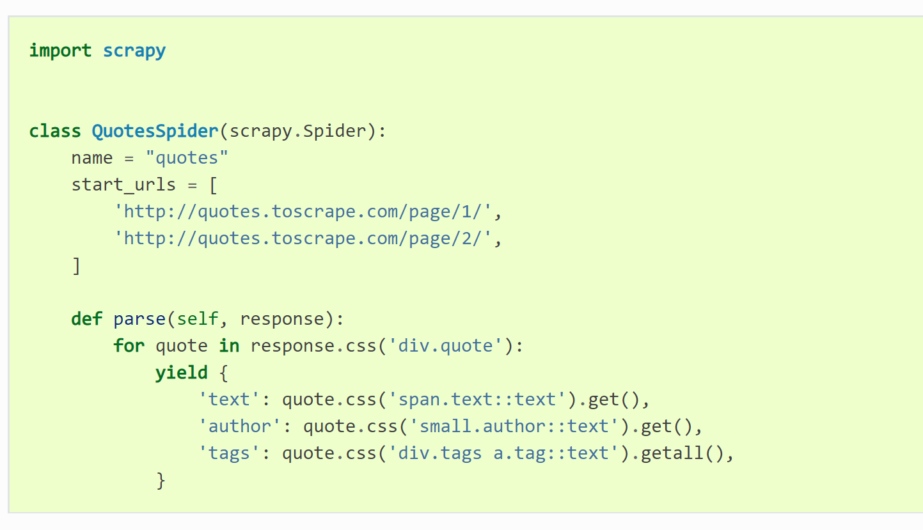
Extracting data in our spider
Start Anaconda Prompt
cd C:\Users\Administrator\tutorial
scrapy crawl quotes
修改代码如右边所示

Slide 23
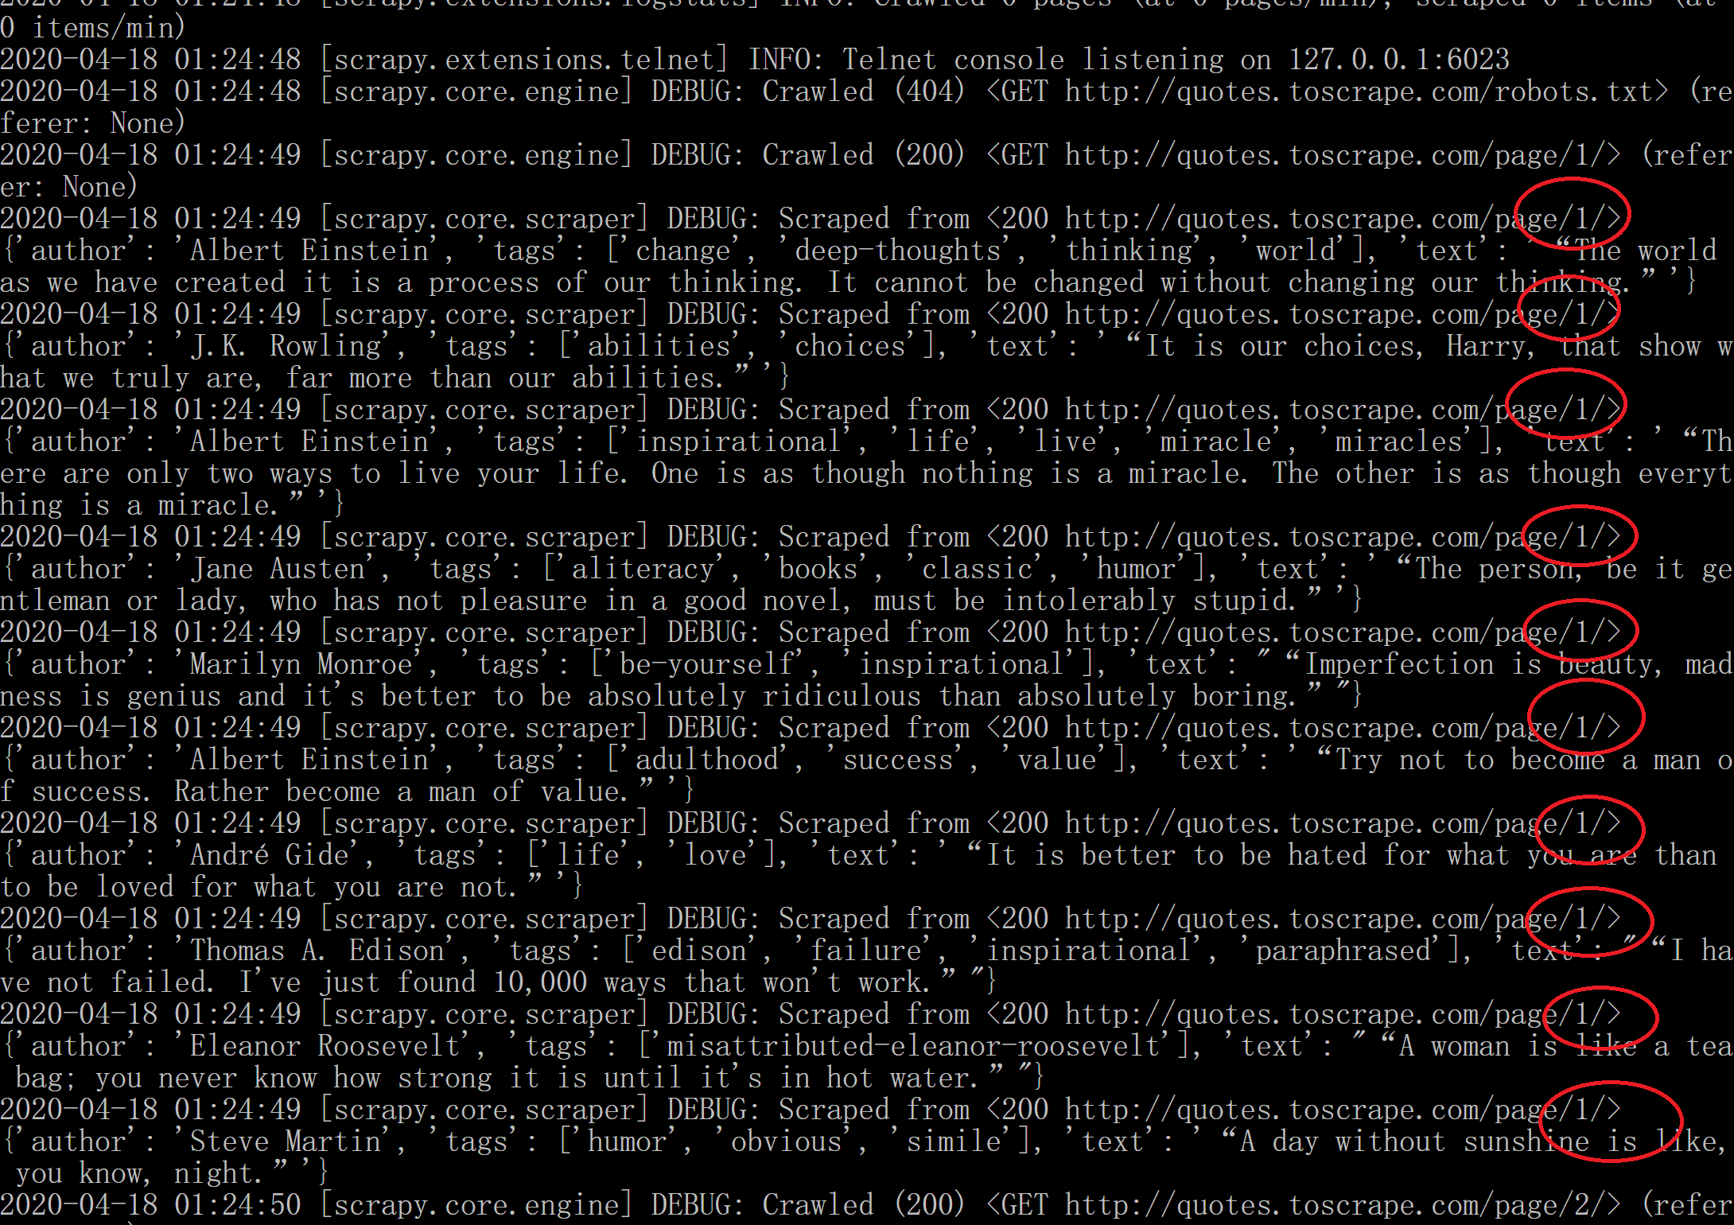
Extracting data in our spider
Start Anaconda Prompt
cd C:\Users\Administrator\tutorial
scrapy crawl quotes

Slide 24
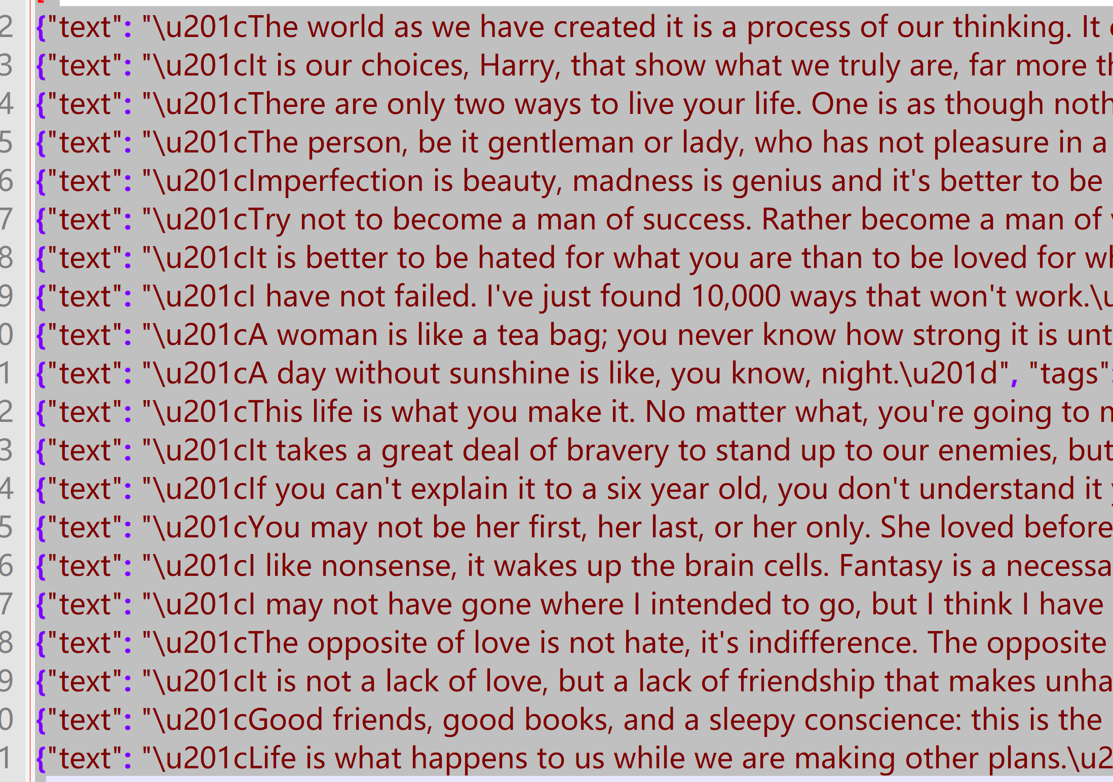
Storing the scraped data
Start Anaconda Prompt
cd C:\Users\Administrator\tutorial
del -y quotes.json
scrapy crawl quotes -o quotes.json
输出结果，写入quotes.json文件

Slide 25
pause

Slide 26
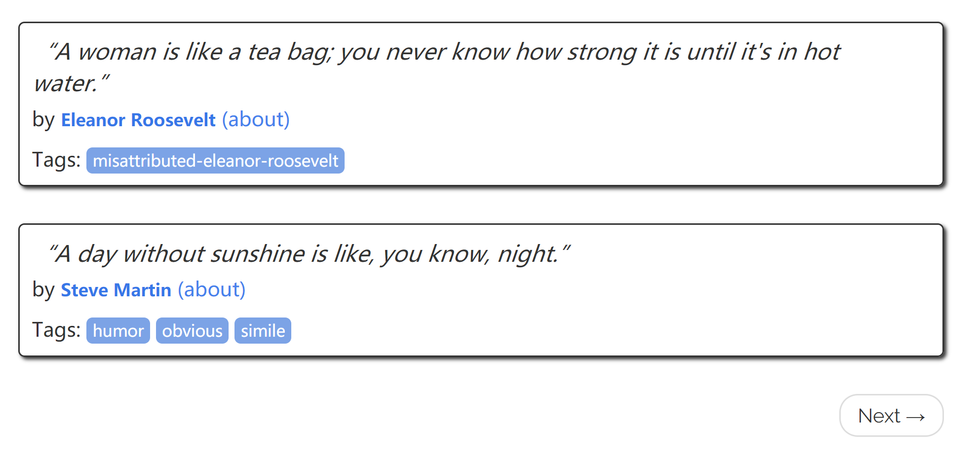
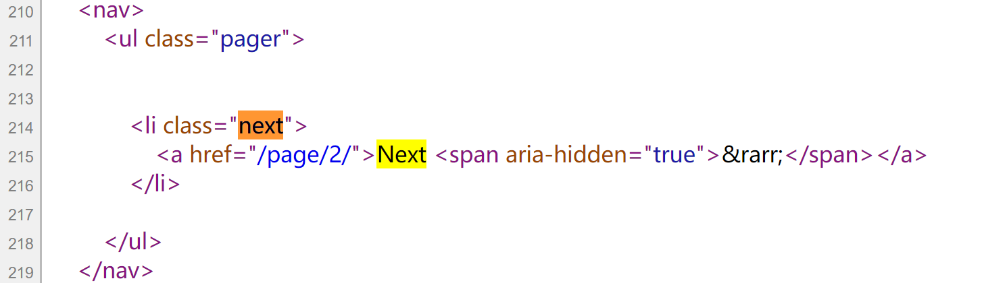
Following links
you want quotes from all the pages in the website
这是下一页的链接

Slide 27
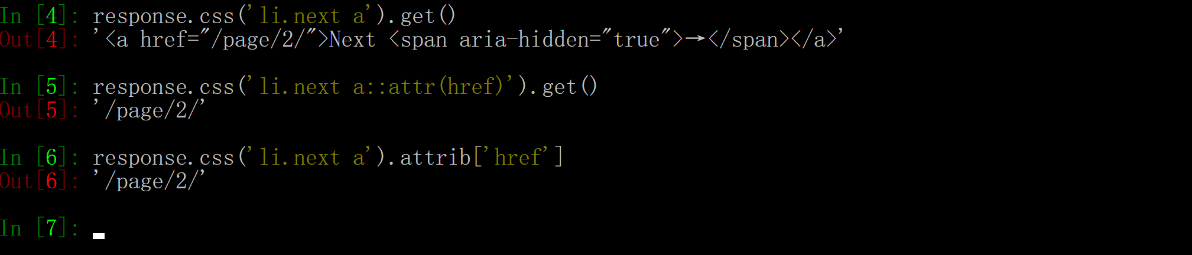
Following links
you want quotes from all the pages in the website.
Start Anaconda Prompt
cd C:\Users\Administrator
scrapy shell "http://quotes.toscrape.com"
Start Scrapy shell
尝试如下命令
response.css('li.next a').get()
response.css('li.next a::attr(href)').get()
response.css('li.next a').attrib['href']

Slide 28
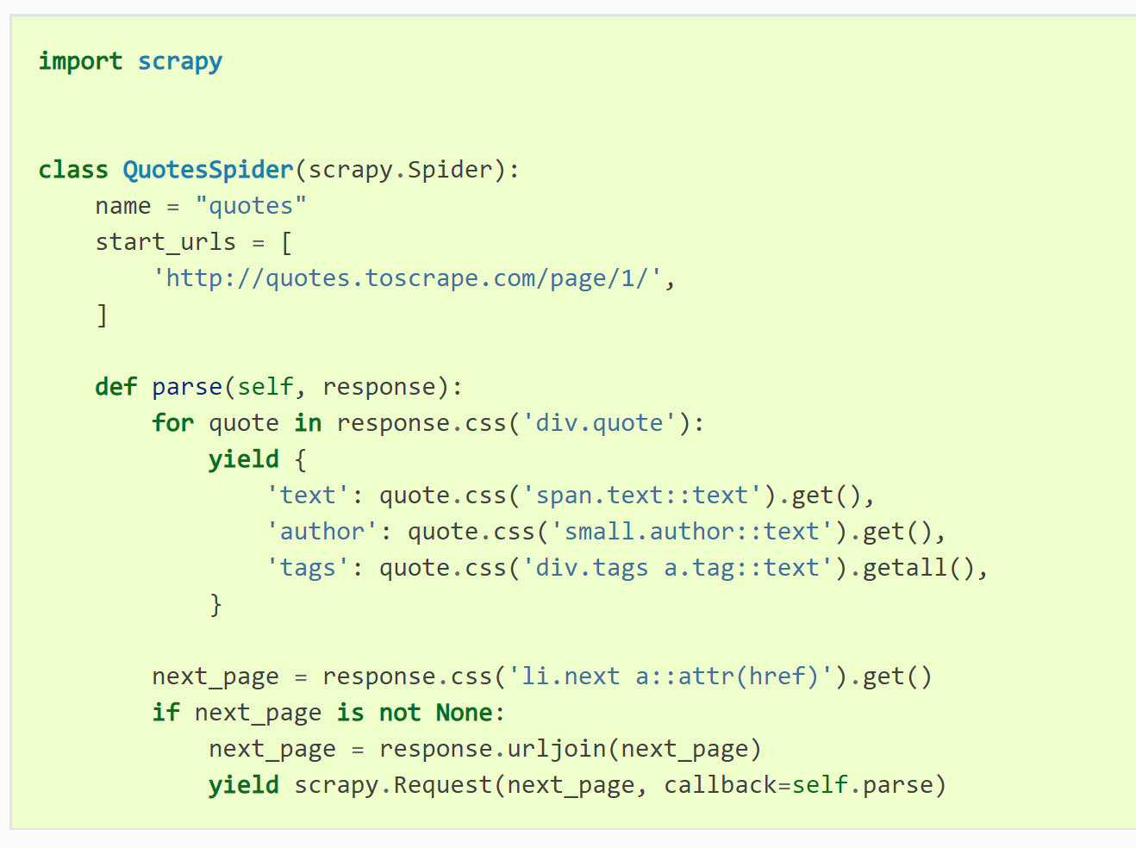
Following links
Following links实验
修改代码如下
Start Anaconda Prompt
cd C:\Users\Administrator\tutorial
scrapy crawl quotes
这时候，将显示网站的所有quotes信息

Slide 29
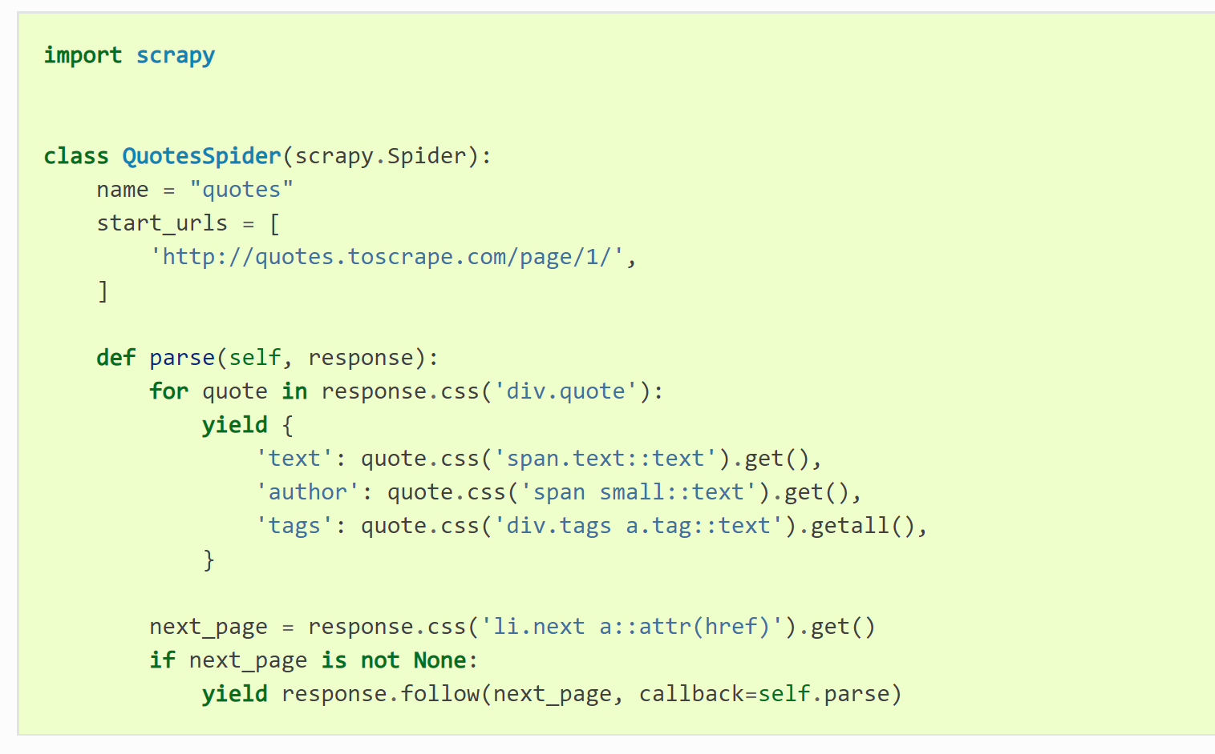
Following links
Following links实验
修改代码如下
Start Anaconda Prompt
cd C:\Users\Administrator\tutorial
scrapy crawl quotes
Unlike scrapy.Request, response.follow supports relative URLs directly - no need to call urljoin

Slide 30
pause

Slide 31
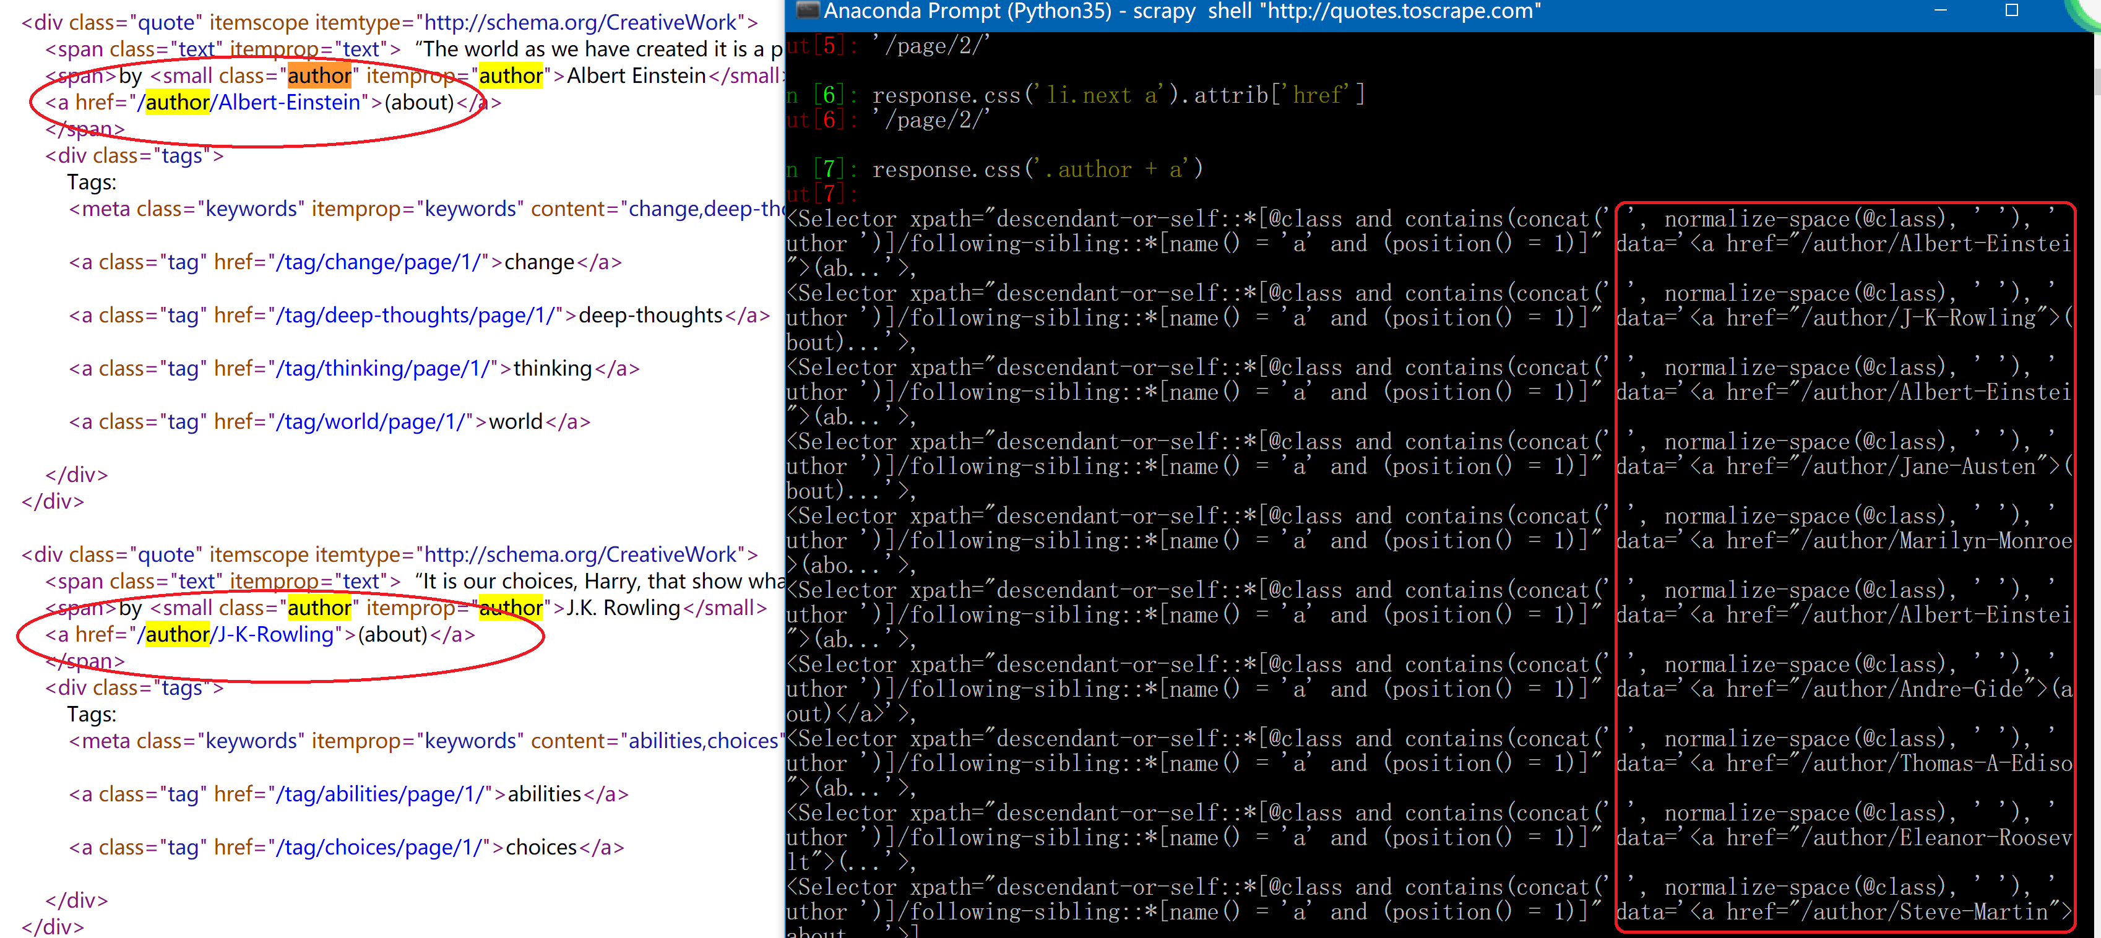
for scraping author information
提取author信息

Slide 32
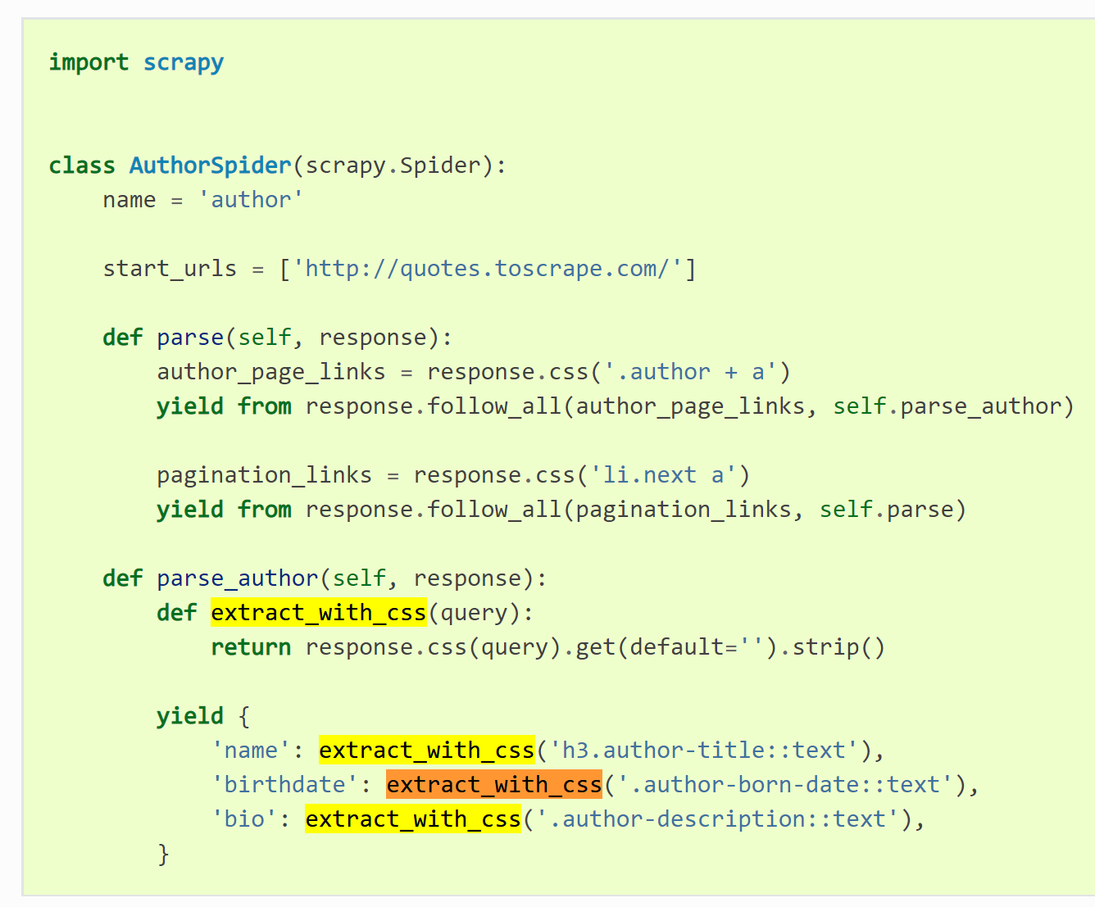
for scraping author information
scraping author实验
增加AuthorSpider，代码如右边所示
Start Anaconda Prompt
cd C:\Users\Administrator\tutorial
scrapy crawl author
This spider will start from the main page, it will follow all the links to the authors pages calling the parse_author callback for each of them, and also the pagination links with the parse callback as we saw before
Scrapy filters out duplicated requests to URLs already visited, avoiding the problem of hitting servers too much because of a programming mistake

Slide 33
pause

Slide 34
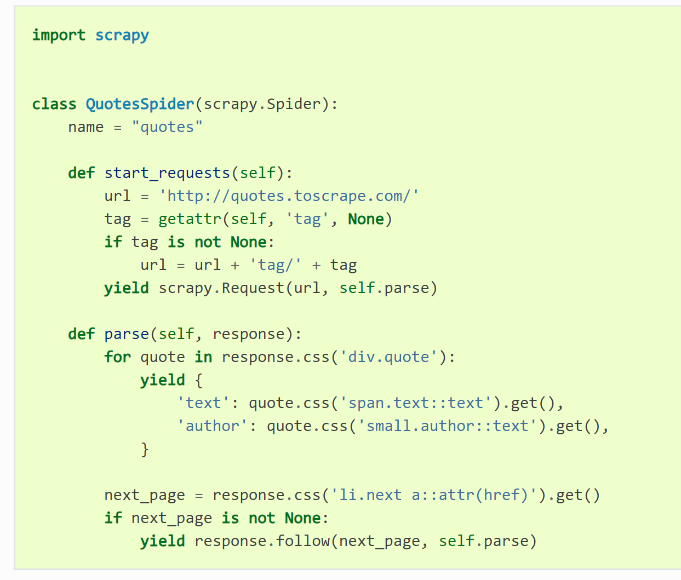
Using spider arguments
spider arguments实验
修改代码如下
Start Anaconda Prompt
cd C:\Users\Administrator\tutorial
scrapy crawl quotes -o quotes-humor.json -a tag=humor

Slide 35
Next step
更多专题
Auto 登录
验证码
数据入库csv, MySQL, MongoDB,…
动态网页、反反爬
爬Video
爬Pictures
……
多线程、分布式爬虫
urllib
Requests
Beautiful soap
lxml
re与正则表达式
Selenium……
猫眼电影、知乎网站
瓜子二手车、豆瓣
赶集、58同城
51Job、招聘、猎聘
链家、搜房……
可以使用的Python库
可以爬取的网站

